Slide 1


CSE2259 - Web Technology
Department of Computer Science Engineering
School of Engineering

Slide 2
Module II - Syllabus
MODULE II: Advanced CSS [L-8hrs.,P- 8hrs.]
Advanced CSS: Layout, Normal Flow, Positioning Elements, Floating Elements, Constructing Multicolumn Layouts, Approaches to CSS Layout, Responsive Design, CSS Frameworks
XML: Basics, demonstration of applications using XML

Slide 3
XML Introduction
The Extensible Markup Language (XML) was developed in 1996 by the World Wide Web Consortium’s (W3C’s) XML Working Group, and it became a W3C recommendation in 1998.
There are two versions of XML.
XML 1.0
XML 1.1

Slide 4
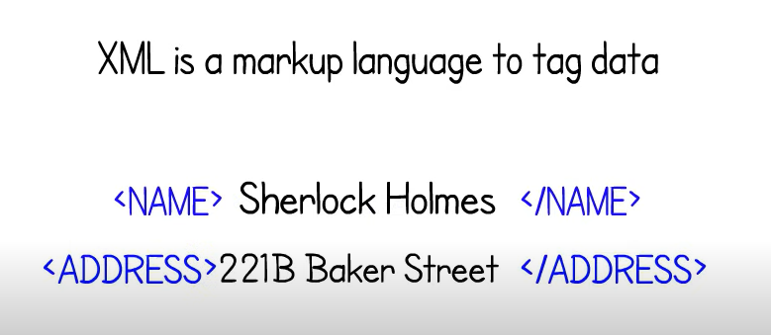
XML

Slide 5
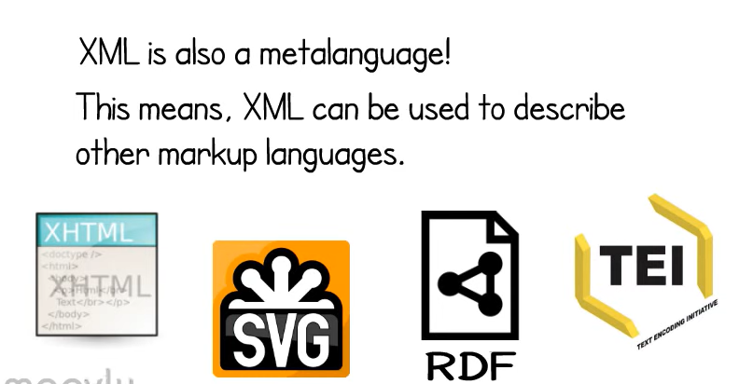
XML

Slide 6
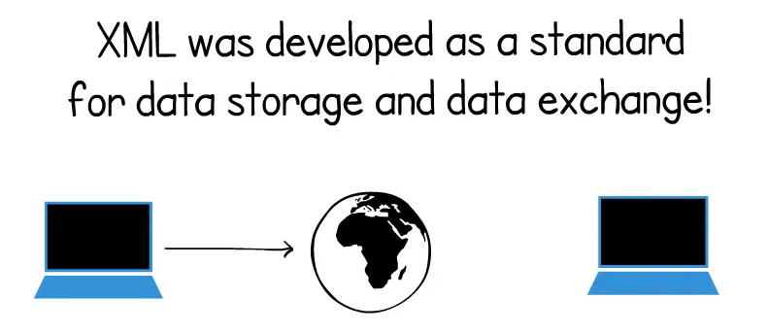
XML

Slide 7

XML

Slide 8
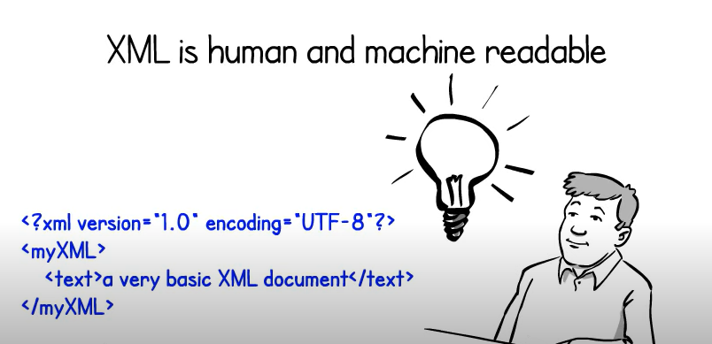
XML

Slide 9
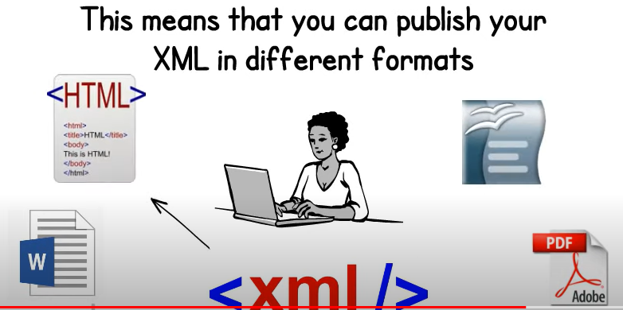
XML

Slide 10
XML Features
It is extensible and human-readable.
It is platform and language independent.
It separates data from HTML.
XML tags are not predefined. You need to define your customized tags.
XML was designed to carry data, not to display that data.
Mark-up code of XML is easy to understand for a human.
Well-structured format is easy to read and write from programs.
XML is an extensible markup language like HTML

Slide 11
XML Encoding
Encoding is the conversion of Unicode characters to their binary representation. UTF is use for XML encoding. UTF stands for UCS (UCS stands for Universal Character Set) Transformation Format.
Mainly, there are two types of UTF encoding.
UTF-8 : UTF-8 uses 8-bits to represent the characters.
<?xml version="1.0" encoding="UTF-8"?>
UTF-16 : It uses 16-bits to represent the characters.
<?xml version="1.0" encoding="UTF-16"?>

Slide 12
XML Syntax
<?xml version = "1.0" encoding = "UTF-8" ?>
<root>
<child>
<subchild>.....</subchild>
</child>
</root>
XML Declaration
<?xml version="1.0" encoding="UTF-8" standalone="no" ?>

Slide 13
XML Elements
Opening tag, content, and closing tag, altogether, is referred to as an element.
Opening tag + content + closing tag = an element
<age> 20 </age>
age - is the name of the element.
<age> – opening tag
25 – content
</age> – closing tag.

Slide 14
XML Elements
Element Rules
Following list shows XML tag and element rules.
Tags are case sensitive.
All XML documents must contain a single root element.
All elements must have a closing tag (except for declarations).
A tag name must begin with a letter or an underscore, and it cannot start with the XML.
A tag name can contain letters, digits, hyphens, underscores, and periods. Hyphens underscore, and periods are the only punctuation marks allowed.
A tag name cannot contain spaces.
All elements must be nested properly.

Slide 15
XML Attributes
Attribute for an element is placed after the tag name in the start tag. You can add more than one attribute for a single element with different attribute names.
<company name="ABC Holdings" location="London">
<chairman>Mr. John</chairman>
<gm>Mr. Wood</gm>
</company>
There are two attributes in the company element, i.e. name and location

Slide 16
XML - Validation
Validation is a process by which an XML document is validated. An XML document is said to be valid if its contents match with the elements, attributes and associated document type declaration(DTD), and if the document complies with the constraints expressed in it. Validation is dealt in two ways by the XML parser.
They are −
Well-formed XML document
Valid XML document

Slide 17
XML DTD
DTD stands for Document Type Definition. It defines the structure of an XML document using some legal elements. XML DTD is optional.
DTD Rules
If DTD is present, it must appear at the start of the document (only the XML declaration can appear above the DTD).
The element declaration must start with an ! mark.
The DTD name and element type of the root element must be the same.

Slide 18
XML Namespaces
Namespaces help to avoid element name conflicts.
Namespace Declaration -
<element xmlns:name="URL">
In the above declaration,
The xmlns keyword indicates the beginning of the namespace.
The name is the prefix of the namespace.
The URL is the namespace identifier.

Slide 19
XML Namespaces
Examples of Namespaces
<?xml version="1.0" encoding="UTF-8" ?>
<abt:person xmlns:abt="https://www.guru99.com/about-us.html">
<abt:founder>Krishna</abt:founder>
<abt:vision>Fun and Free Education for ALL</abt:vision>
</abt:person>

Slide 20
XML Schemas
XML schema (also known as XML schema definition or XSD) use to describe the XML document structure. It is an alternative to DTD.
Why Schema is Important?
DTD is not powerful as schema as it is not extensible and flexible enough. So, it may not be suitable for some situations. In such a situation schema is important.
The main purpose of using XML schema is to define the elements and attributes of an XML document.

Slide 21
XML Schemas
Following code segment shows an example of XML schema.
<xs:schema xmlns:xs = "http://www.w3.org/2001/XMLSchema">
<xs:element name = "employee">
<xs:complexType>
<xs:sequence>
<xs:element name = "firstname" type = "xs:string" />
<xs:element name = "lastname" type = "xs:string" />
<xs:element name = "phone" type = "xs:int" />
</xs:sequence>
</xs:complexType>
</xs:element>
</xs:schema>

Slide 22
XSL - EXtensible Stylesheet Language
Need for XSL
HTML document, tags are predefined such as table, div, and span; and the browser knows how to add style to them and display those using CSS styles.
But in case of XML documents, tags are not predefined.
In order to understand and style an XML document, World Wide Web Consortium (W3C) developed XSL which can act as XML based Stylesheet Language.
An XSL document specifies how a browser should render an XML document.

Slide 23
XSL - EXtensible Stylesheet Language
Following are the main parts of XSL −
XSLT − used to transform XML document into various other types of document.
XPath − used to navigate XML document.
XSL-FO − used to format XML document.
What is XSLT
XSLT, Extensible Stylesheet Language Transformations, provides the ability to transform XML data from one format to another automatically

Slide 24
XSL - EXtensible Stylesheet Language
XSL Execution Procedure refer the link - https://www.tutorialspoint.com/xslt/xslt_syntax.htm

Slide 25
XML Reference
https://www.guru99.com/xml-tutorials.html

